Slide 1
Yellow Flags
Rachael Wood
Specialist Physiotherapist
HPC, MCSP, MMACP, FHEA
BSc(hons),
PGdip(adv-prac)
PGCEHE
MSc Rehabilitation

Slide 2
ILO
By the end of this session students will be able to…
Identify yellow flags
Explain the clinical significance of yellow flags
Describe the action that a physiotherapist should take if yellow flags are present
Explain why the detection of red and yellow flags fits into the back pain care pathway

Slide 3
Key References
New Zealand Guidelines Group., 2004. New Zealand Acute Low Back Pain Guide. Wellington: ACC
Butler D & Mosely L (2003) Explain Pain Adelaide: Noi group publications
French, S. and Sim, J., 2004. Physiotherapy: A Psychosocial Approach. 3rd ed. Edinburgh: Elsevier.
Greenberger D & Padesky C (1995) Mind over Mood New York: The Guilford press.
Kolt, G. and Andersen, M.B., 2004. Psychology in the Physical and Manual Therapies. Edinburgh: Churchill Livingstone.
Melzack R & Wall PD (1996) The Challenge of Pain London: Penguin
Waddell, G. 2004. The Back Pain Revolution. Edinburgh: Churchill Livingstone

Slide 4




Evidence
European Guidelines (2006)
  www. backpaineurope.org
New Zealand Guidelines (2004)
  www.nzgg.org.nz
NICE
http://www.nice.org.uk/CG88
CSP (2007)
Notes:
European Guidelines (2006)
Need for combined approach to management exercise and CBT.
Need for consistent team approach.
Do not recommend detailed anatomy approach.
New Zealand Guidelines
Provided concept of yellow flag
Pioneer the introduction of biopsychosocial approach
Introduction of blue and black flags
Cochrane
New back group.
Big changes within the group has led to fluctuations in recommendations.
Await new publication.
CSP
Recent guideline publications.
Journal club review.
Discussion on how to change our current programme linked to these.

Slide 5

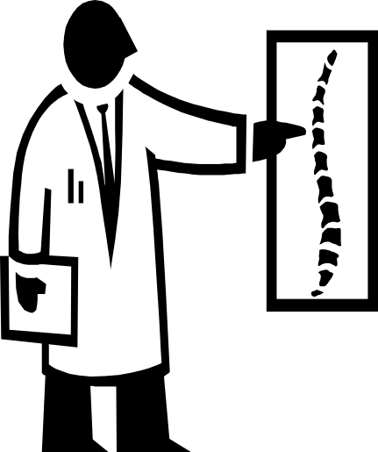
LOW BACK PAIN CARE PATHWAY
low back pain
No referral
Red flags
No red flags
refer on -
Rheumatology/ortho
PSYFs
No PSYFs
Refer on to the
‘About your back service’
Advise and reassure
Better in a week
No better in a week
Refer for mechanical
assessment

Slide 6
Consider some of the most unhelpful things a professional has said to you.

Slide 7
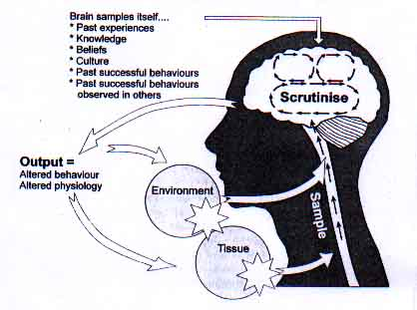
Mature Organism Model
Gifford 1998

Slide 8
Key question to ask when screening for these factors:
What can be done to help this person experience less distress and disability?

Slide 9
Pain
Types of Pain

Slide 10
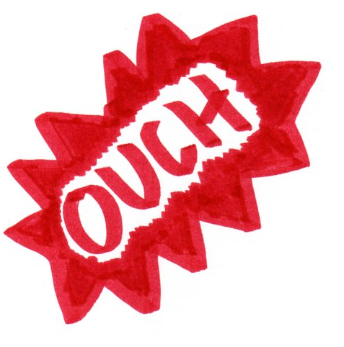
Acute Pain
Acute pain warns of potential or actual tissue damage. eg. Touching an oven
Acute pain remains during most of the healing process.
Memory of pain protects us from making the same mistake again. eg. We are all careful around the oven!
Tissues have different healing rates…
  Skin = Days
  Muscle = Weeks
  Bones = Months
All healing will be completed within 3-6 months.
Chronic pain persists when healing has finished.
The terms ‘Acute’ and ‘Chronic’ pain do not indicate how severe the pain is, just how long you have had it.

Slide 11
Chronic Pain
Chronic pain persists after 6 months when all healing is completed.
Acute pain awakens and alerts our nervous system. In Chronic pain this sensitivity of the nervous system remains even though the injury has resolved.
Chronic pain does not seem to have any purpose.
In some it begins with an acute injury. Often the specific cause tends to be less clear and pain just gradually develops over time.
Nerves become more sensitive, increasing the likelyhood that the brain will interpret messages as pain. This sometimes means sensations that are not painful, are experienced as pain. This may happen even after the injury has resolved.
This can mean that simple stretching, pressure, or light touch can be interpreted by the brain as pain and create the same painful symptoms as the original injury.

Slide 12
Pain System
Body Detection
  Sensors, which detect mechanical, temperature and chemical changes, send messages to the spinal cord via nerves.
  There are some more special sensors for ears, eyes, nose, mouth but no pain sensors.
  There is a similar distribution of each sensor all over the body, the concentration varying for different areas.
  Hands and lips have lots of sensors, Tummy and upper arm have very few. This is why a cut on your hand or lip feels so big and painful.
Brain Reaction
  The brain makes sense of messages from the sensors.
  Input from all the sensors put together can lead to the brain interpreting it as pain.
  The brain can either…
    1) Accept the pain message as danger and send a response to do something about it.
    2) Realise the pain sensation is not a concern and send a message to not respond.
Spinal Cord Modification
  The spinal cord transmits these messages and has the ability to modify them.
  The process is often described as the ‘Pain Gate’.

Slide 13
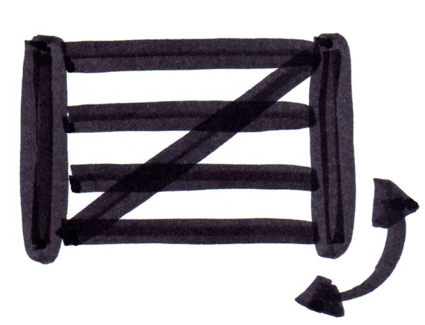
Pain Gate
The nervous system has the ability to change its awareness to sensations.
Examples include…
  Footsteps behind you seeming louder when you are alone at night.
  Being unaware of feeling your wristwatch.
  Soldiers walking from battle on a broken leg.
The pain gate can be fully open, ajar or closed; changing the brains experience of pain.
In Chronic pain states the gate is open due to the nervous systems increased sensitivity and poor health.
This is why simple stretching, movement or pressure (even light touch) can be interpreted as pain.
The gate can be controlled consciously and subconsciously.
This does not mean the pain is not real but it does mean you can have a strong influence on how much pain you feel and the impact it has on you!

Slide 14
Close Gate / Open Gate
Things that may close the pain gate…
  Tablets
  Rest
  Massage
  Work
  Distraction
  Pleasure
  Relaxation
  Heat
  Cold
  TENS
  Exercise
Things that may open the pain gate…
  Anxiety
  Stress
  Fear
  Depression
  Tiredness
  Boredom
  Sustained positions
  Overdoing things
  Weather
  Menstruation
  Inactivity
  Touching the painful area
Ajar Gate
When the pain gate is ajar some pain messages will get through

Slide 15
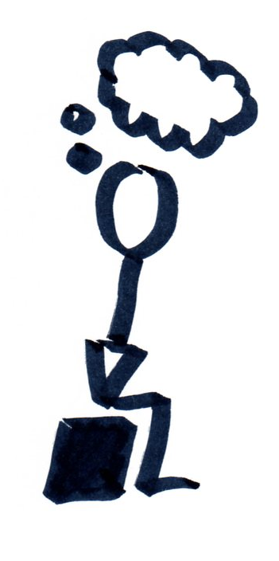
Pain Psychology
It is well known that psychological factors can cause dramatic changes in performance of professional sports people without any change in ability or fitness.
Your psychology can equally influence your experience of chronic pain.
Pain levels can fluctuate due to moods, fears and anxieties without any physical changes occurring.
Many of the emotions are involved in opening and closing the pain gate.
  Pleasure
  Happiness
  Relaxation
  Anxiety
  Stress
  Depression
  Fear
  Boredom
  Tiredness
These emotions are often used in sports professionals to improve performance and can equally be used by anybody to influence pain and physical activities.
  .

Slide 16
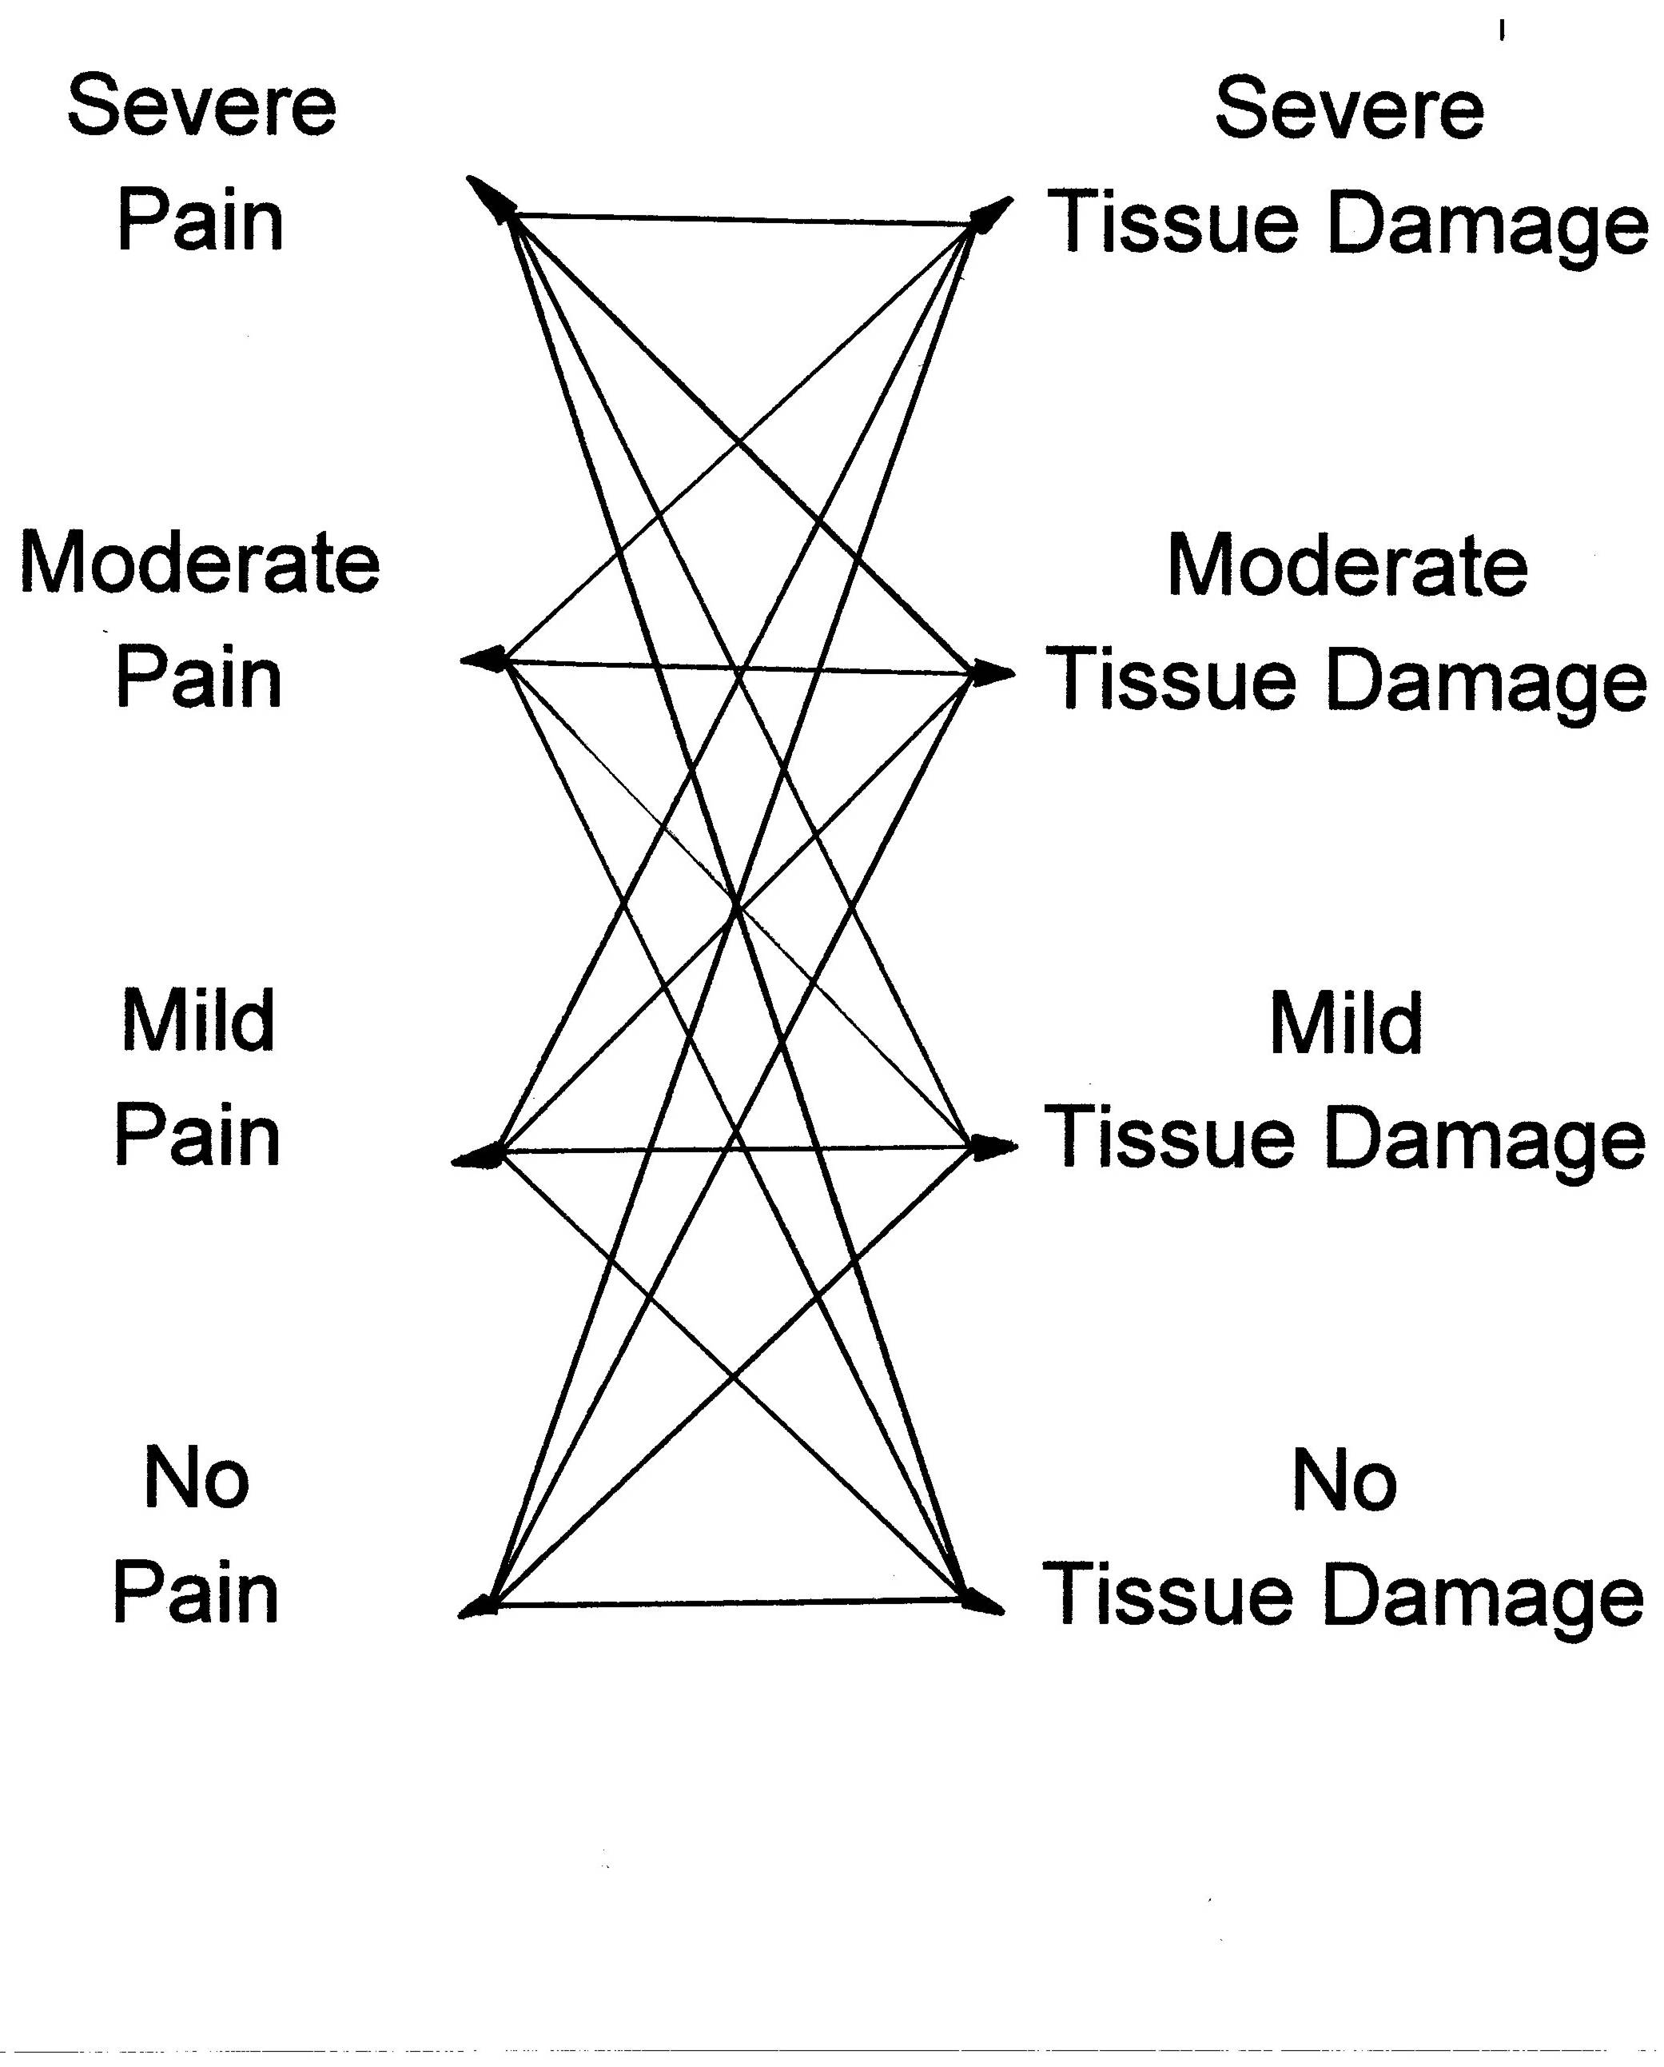
Pain & Damage Relationship

Slide 17
Examples…
Severe damage and little pain…
  Walking from a car crash on a broken leg.
  Soldiers who find bullets imbedded when x-rays are taken years later.
  Disc bulges on MRI when there is no pain.
  Rugby players who are injured but continue to play.
  Winners and losers in the boat race or any match.
Little damage but a lot of pain…
  Headache.
  Menstrual cramp.
  Paper cut
  Trapped wind
  Father with labour pain.
  Back pain.
  Buttock ache from sitting on a chair too long.
  Phantom limb pain.

Slide 18
Does Pain Mean Damage?
Pain does not always mean damage.
You can experience damage without pain (eg.Wounded soldier).
You can experience pain without damage (eg.Headache).
Other stimulus such as stretching or light touch can be interpreted by the brain as pain if there is increased sensitivity of the nervous system.
Increases in pain levels in chronic pain does not signify a new injury.
Because psychological factors can be involved it does not mean the pain is imaginary.

Slide 19
Why can no-one tell me what is wrong?
When pain has continued for a long time it is unlikely that one thing can be isolated as the cause.
The initial injury will have healed after 6 months. Remaining problems include weakness, stiffness and altered posture.
It is likely that the causes of longer term pain are complex.
Sensitivity and changes in the nervous system and the brains experience of pain, means pain continues without a structure to blame in the spine.
Chronic pain is a disorder of function rather than a disorder of structure.

Slide 20
Musculoskeletal
Relationship to pain

Slide 21
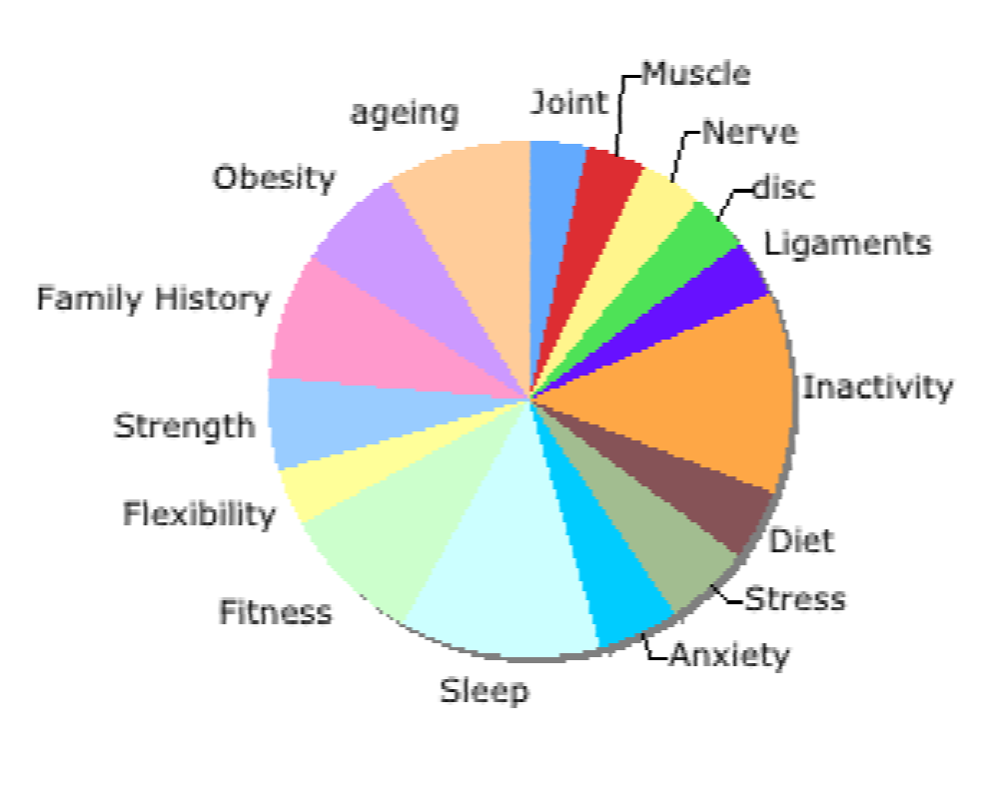
No Specific Cause
There are many structures which can cause pain (local or referred) and in most cases, no single structure is the specific cause.
The back is strong as it is well supported by joints, muscles and ligaments.
Discs, joints, ligaments, nerves and muscles need to move to keep strong and healthy.

Slide 22
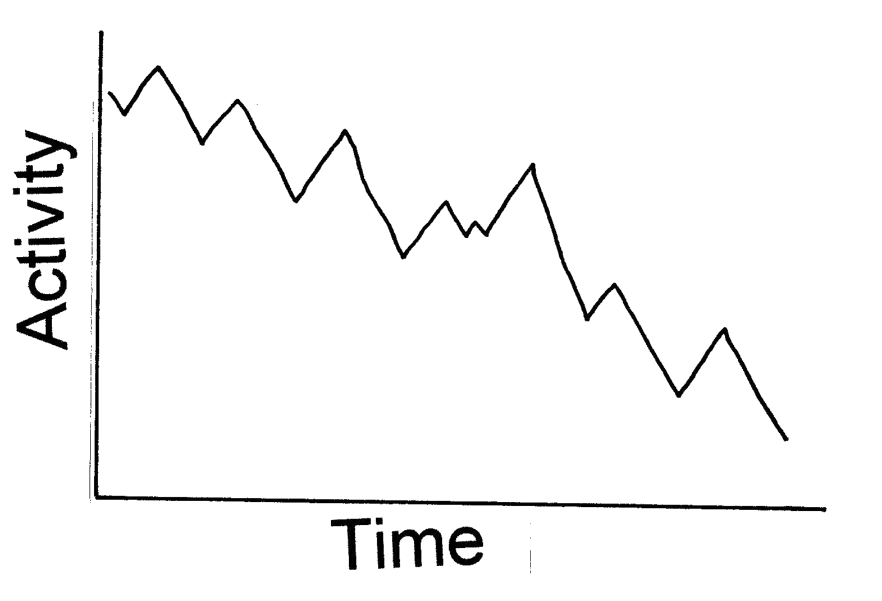
Deconditioning
The first episode of pain may result in reduced activity.
Reduced activity may cause physical changes such as muscle weakness and joint tightness.
If physical changes continue over-time and the previous strength and fitness is not recovered, another episode of pain may develop.
This time it may take longer to recover.
  The Deconditioning Cycle

Slide 23
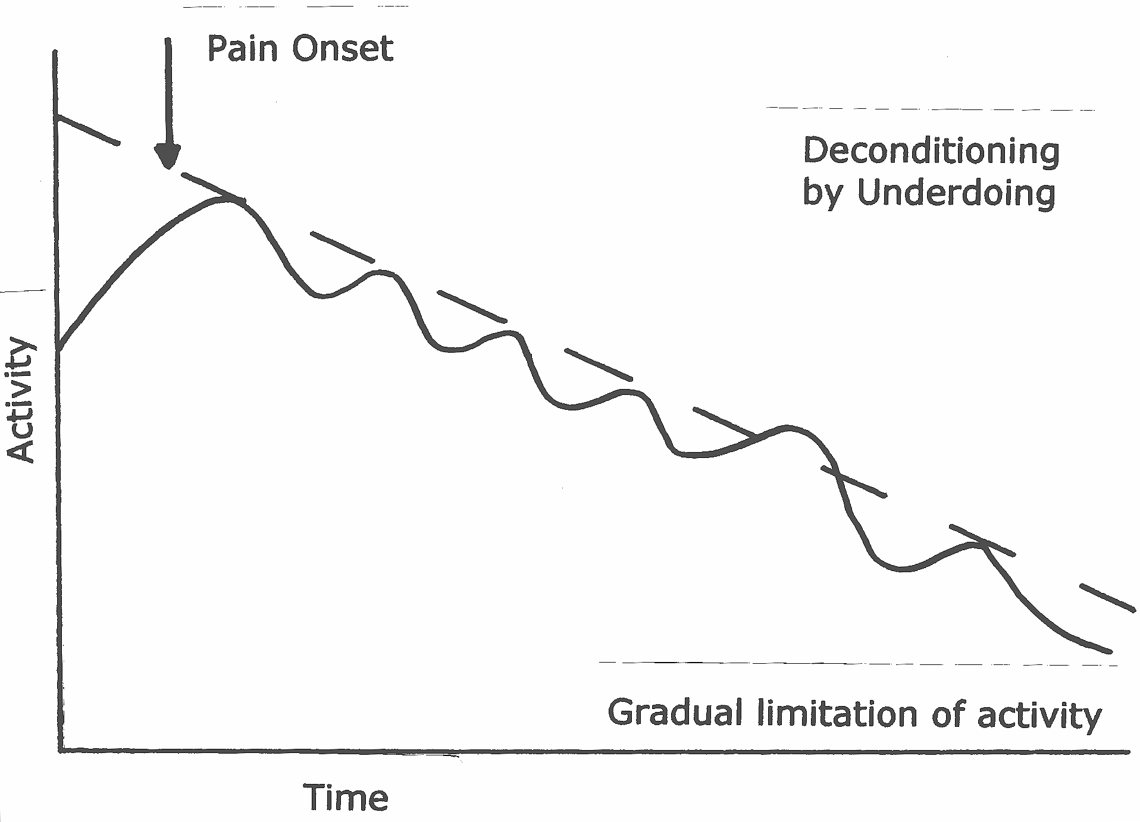
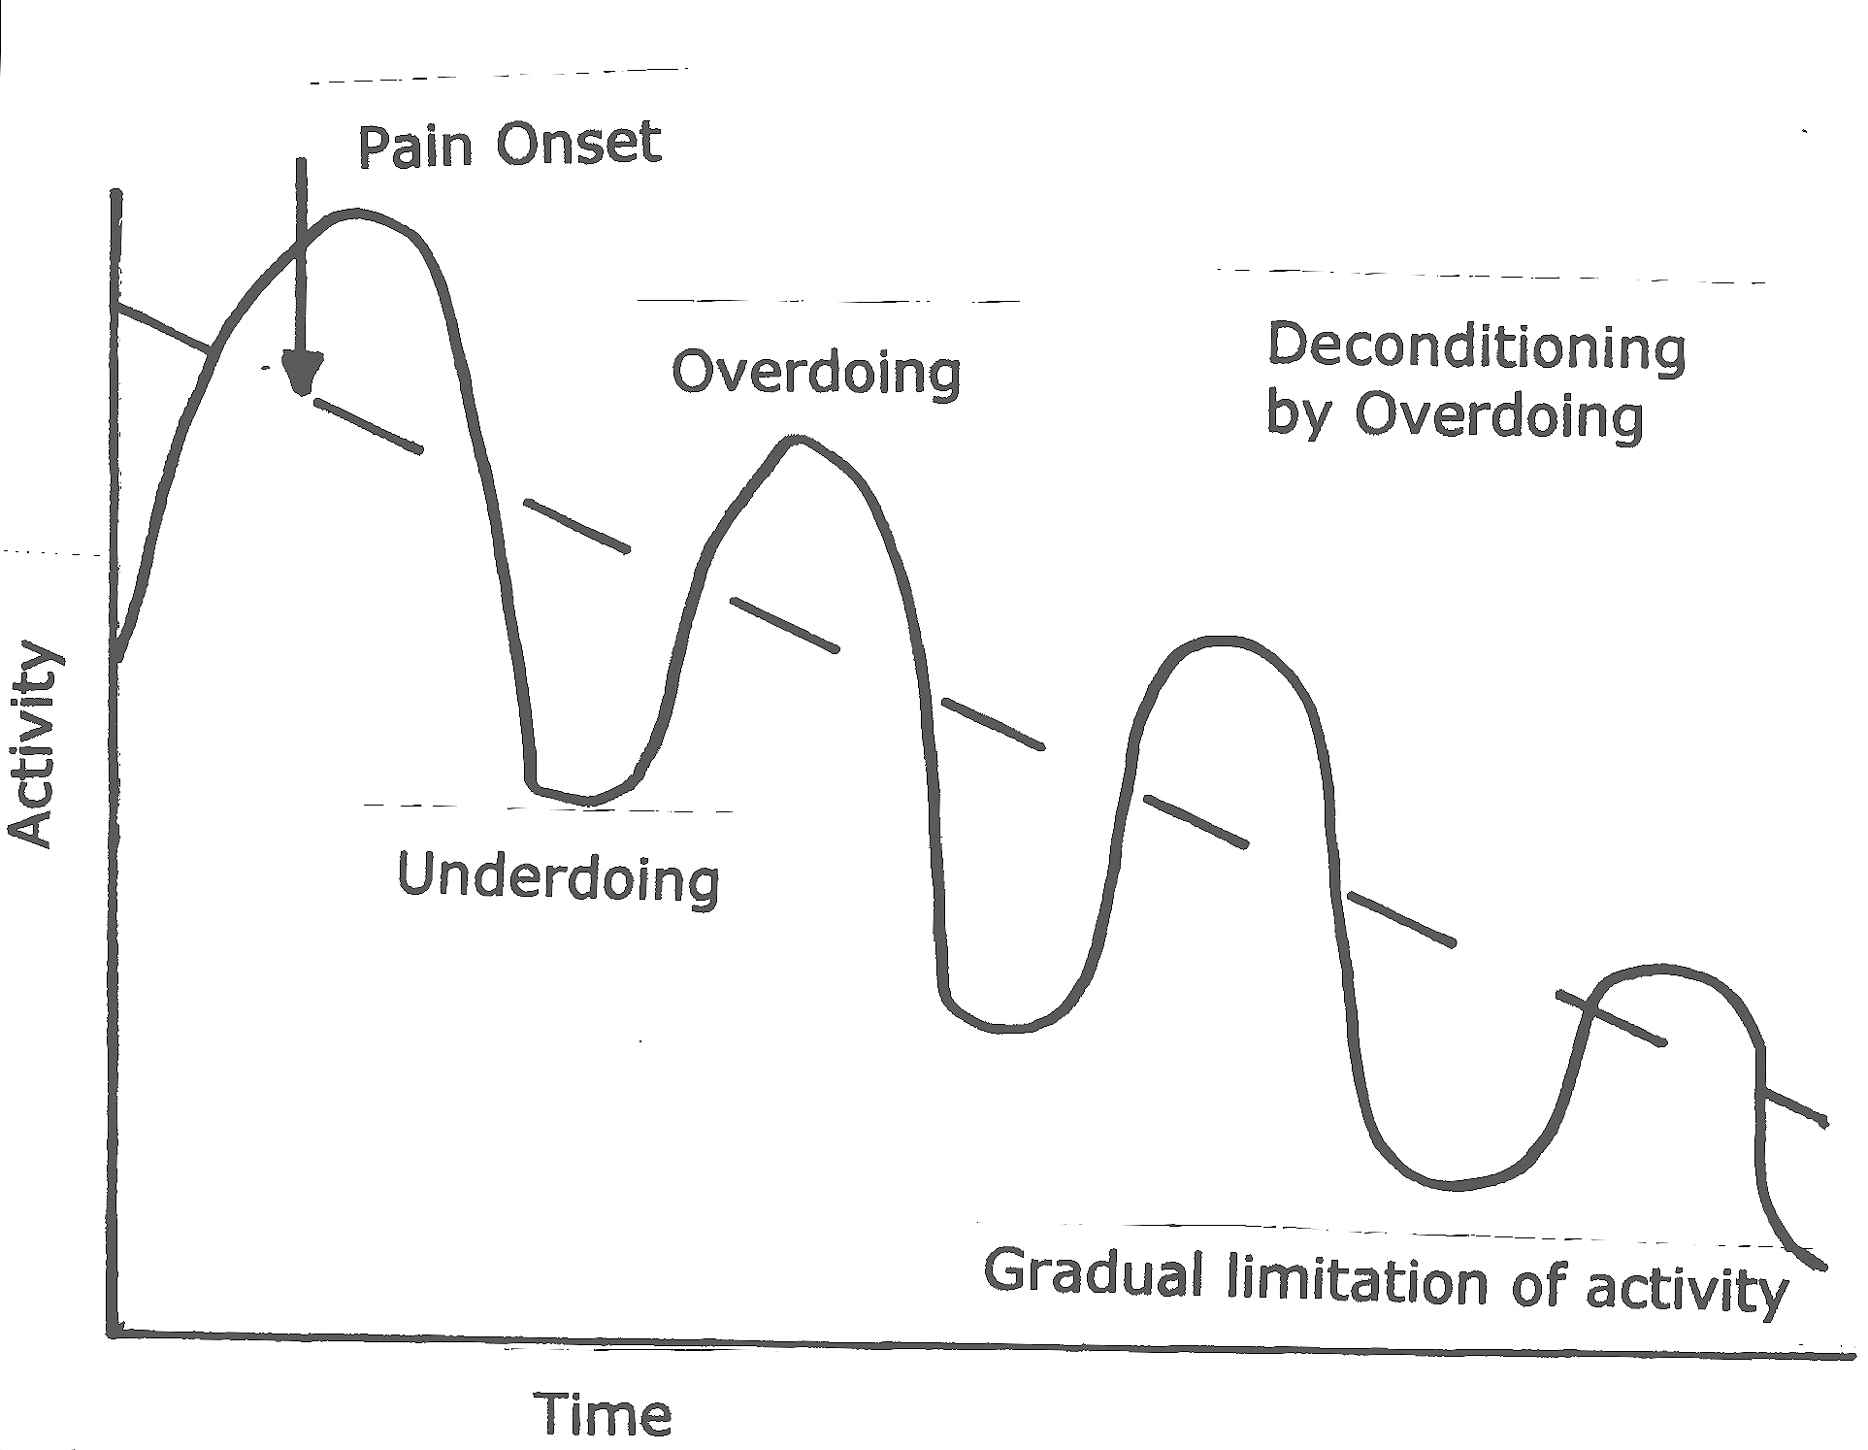
Deconditioned
Becoming deconditioned often happens without us realising, sometimes slowly over several years.
This may happen while we are busy waiting for a medical diagnosis.
Persisting pain typically displays good and bad spells. Good days and bad days, good weeks and bad weeks.
Similarly levels of activity fluctuate. Some days you can manage more than others.
We often look for a reason for these fluctuations and avoid certain activities if we feel these are to blame.
Ultimately pain is controlling your life.

Slide 24
Normal Aging
Changes are a normal part of the aging process.
In the spine this begins as early as 30 years old. In fact 10% of individuals aged 10-20 years have degenerate discs. (Miller et al, 1988)
Names for these changes include:
  Wear and tear
  Osteoarthritis
  Degenerative spine disease,
  Black disc disease
  Spondylosis
These changes usually only produces symptoms when other factors are involved such as…
  Immobility
  Poor fitness
  Poor flexibility
  Poor Strength
  Strain
  Posture
  Stress
  Anxiety
  Depression
  Pain mechanisms
  Lifestyle
  Sleep patterns
  Family history
  Injury
  Over weight

Slide 25
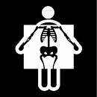
X-rays & Scans
X-rays and scans are pictures of the inside of the body.
  X-rays show bones
  MRI scans show soft tissues and bones.
  X-ray has high radiation exposure and therefore is less often used now.
Changes reported from scans are usually normal age related changes.
It is important to understand that these are not serious but can be painful.
X-rays and scans do not show pain.
So we do not know which (if any) age related changes are causing the pain.

Slide 26
Psychosocial
Relationship to pain

Slide 27

Fight or Flight
Instinctive stress response
ADRENALINE
ENDORPHINS
SEROTONINS
Increased breathing rate.
Increased heart rate.
Muscles are tensed and ready for action.
Digestion stops.
Blood rushes away from non-vital (eg. stomach) towards vital organs (eg. heart & muscles).
Nervous system sensitivity is increased.
The brain is less likely to interpret information as pain.
Stress response is for primitive survival to prepare our bodies to fight or run from danger.

Slide 28
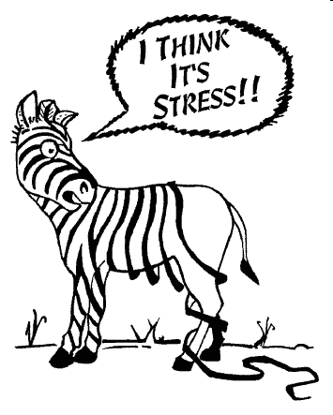
Stress
Stress chemical responses are designed for short term release.
A long term stress response is unhelpful and may cause problems.
Examples…
  Muscle tension
  Stomach ulcers
  Digestive problems
  Headaches
  Pain
  High blood pressure
  Poor sleep
Nervous system sensitivity remains increased.
The brain is now more likely to interpret information as pain because of this long term increased sensitivity of the nervous system.
It is important to manage stress levels effectively.

Slide 29
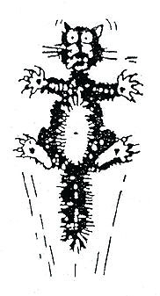
Fear
Fear of pain during movement is a common anxiety.
Anticipation of pain makes us anxious.
Anxiety stimulates the response that makes us more sensitive to pain.
This causes us to avoid situations that may make us feel anxious.
Avoiding things can seriously reduce our quality of life and life experiences.
Sometimes it is important to try things to see if the worst really does happen.
If it turns out to be ‘OK’ our anxiety will be reduced and pain levels less.

Slide 30
Unhelpful Thoughts
Feeling thoughts and behaviour are closely linked. Ongoing pain can provoke thoughts which make you feel miserable, frustrated and helpless.
These unhelpful thoughts are a common occurrence in chronic pain and at times of stress in our lives
  “I’m not getting anywhere.”
  “I’ll feel worse if I do this.”
  “I’ll never be able to do this.”
Unhelpful thoughts
  Can affect everyone from time to time.
  Negatively effect mood.
  Can be extremely convincing
  Are often distorted views of reality
  Can reinforce pain symptoms.
  Are usually hard to shift
  Can trap you in a vicious cycle of over or under activity.

Slide 31
It’s the Thought that Counts
How thinking influences pain has briefly considered related to the pain gate.
Thoughts and feelings can further affect behaviour.
It is well known that psychological factors can cause dramatic changes in performance of professional sports people without any change in ability or fitness.
Thoughts beliefs and emotions can equally influence anyone’s experience of any pain.
Pain levels can fluctuate due to moods, fears and anxieties without any physical changes occurring.
Equally thoughts and feelings can lead to some physical changes which can be partly explained by understanding the body and it’s responses to
  Short term stress
  Long term stress
  Fear

Slide 32
Clinical assessment of psychosocial yellow flags
Attitudes and beliefs about pain
Behaviours
Compensation issues
Diagnosis and treatment
Emotions
Family
Work

Slide 33
Attitudes and beliefs about back pain
Belief that pain is harmful or disabling resulting in fear-avoidance behaviour, eg, the development of guarding and fear of movement
Belief that all pain must be abolished before attempting to return to work or normal activity
Expectation of increased pain with activity or work, lack of ability to predict capability
Catastrophising, thinking the worst, misinterpreting bodily symptoms
Belief that pain is uncontrollable
Passive attitude to rehabilitation

Slide 34
Behaviours
Use of extended rest, disproportionate ‘downtime’
Reduced activity level with signifi cant withdrawal from activities of daily living
Irregular participation or poor compliance with physical exercise, tendency for activities to be in a ‘boom-bust’ cycle
Avoidance of normal activity and progressive substitution of lifestyle away from productive activity
Report of extremely high intensity of pain, eg, above 10, on a 0-10 Visual Analogue Scale
Excessive reliance on use of aids or appliances
Sleep quality reduced since onset of back pain
High intake of alcohol or other substances (possibly as self-medication), with an increase
since onset of back pain
Smoking

Slide 35
Compensation issues
Lack of financial incentive to return to work
Delay in accessing income support and treatment cost, disputes over eligibility
History of claim/s due to other injuries or pain problems
History of extended time off work due to injury or other pain problem (eg more than 12 weeks)
History of previous back pain, with a previous claim/s and time off work
Previous experience of ineffective case management (eg, absence of interest, perception of being treated punitively)

Slide 36
Diagnosis and treatment
Health professional sanctioning disability, not providing interventions that will improve
function
Experience of conflicting diagnoses or explanations for back pain, resulting in confusion
Diagnostic language leading to catastrophising and fear (eg, fear of ending up in a wheelchair)
Dramatisation of back pain by health professional producing dependency on treatments and continuation of passive treatment
Number of times visited health professional in last year (excluding the present episode of back pain)
Expectation of a ‘techno-fix’, eg, requests to treat as if body were a machine
Lack of satisfaction with previous treatment for back pain
Advice to withdraw from job

Slide 37
Emotions
Fear of increased pain with activity or work
Depression (especially long-term low mood), loss of sense of enjoyment
More irritable than usual
Anxiety about and heightened awareness of body sensations (includes sympathetic nervous system arousal)
Feeling under stress and unable to maintain sense of control
Presence of social anxiety or disinterest in social activity
Feeling useless and not needed

Slide 38
Family
Over-protective partner/spouse, emphasising fear of harm or encouraging catastrophising (usually well-intentioned)
Solicitous behaviour from spouse (eg, taking over tasks)
Socially punitive responses from spouse (eg, ignoring, expressing frustration)
Extent to which family members support any attempt to return to work
Lack of support person to talk to about problems

Slide 39
Work (Blue Flag)
Blue flags, introduced in 2000, relate to an individual's perception of work.
History of manual work, notably from the following occupational groups:
  Fishing, forestry and farming workers
  Construction, including carpenters and builders
  Nurses
  Truck drivers
  Labourers

Slide 40
Work (Blue Flag)
Work history, including patterns of frequent job changes, experiencing stress at work, job dissatisfaction, poor relationships with peers or supervisors, lack of vocational direction
Belief that work is harmful; that it will do damage or be dangerous
Unsupportive or unhappy current work environment
Low educational background, low socioeconomic status
Job involves significant bio-mechanical demands, such as lifting, manual handling heavy items, extended sitting, extended standing, driving, vibration, maintenance of constrained or sustained postures, inflexible work schedule preventing appropriate breaks
Job involves shift work or working unsociable hours
Minimal availability of selected duties and graduated return to work pathways, with unsatisfactory implementation of these
Negative experience of workplace management of back pain (eg, absence of a reporting system, discouragement to report, punitive response from supervisors and managers)
Absence of interest from employer

Slide 41
Black Flags
Black flag,
Introduced in 2000
Denotes work conditions that could inhibit rehabilitation, such as a job requiring heavy lifting or the wrong height of desk in a fixed work station.

Slide 42
Orange Flags
Orange flags, introduced in 2005, signal abnormal psychological processes or drug abuse. They indicate referral to a specialist is required.
Triage to mental health specialist
Reassess after specialist treatment

Slide 43
Model of How Disability Develops
(Leeuw et al, 2007)
injury
recovery
avoidance
disuse
depression
disability
pain experience
confrontation
fear of
reinjury
catastrophising
no fear
negative affect
anxiety
information
therapist interaction

Slide 44
Questions to ask for psychosocial risk factors
Have you had time off in the past with back pain?
What do you understand is the cause of your back pain?
What are you expecting will help you?
How is your family / employers responding to your back pain
What are you doing to cope?
Do you think you will return to work? When?
(Waddell 2004)

Slide 45
Suggested questions to the worker with low back pain (to be phrased in your own style):
Have you had time off work in the past with back pain?
What do you understand is the cause of your back pain?
What are you expecting will help you?
How is your employer responding to your back pain? Your co-workers? Your family?
What are you doing to cope with your back pain?
Do you think you will return to work? When?
(NZ Guidelines Group, 2004)

Slide 46
Predictive Tools / Outcome Measures
Acute Low Back Pain Screening Questionnaire (p37, NZ Guidelines Group, 2004)
Rolland Morris Questionnaire
Oxford Disability Questionnaire
Patient Self Efficacy
Hospital Anxiety & Depression Score

Slide 47
Key Messages
Acute low back pain is common. Episodes are nearly always short-lived and reassurance is very helpful
Investigations in the first 4-6 weeks do not provide clinical benefit unless there are Red Flags present. There are risks associated with unnecessary radiology (X-rays and CT scans)
The evidence for the benefits of activity has strengthened. This means staying or becoming physically active and resuming usual activities, including work, as soon as possible
Analgesia and manipulation may provide short-term symptom control
Some clinical interventions may be harmful, especially extended bed rest and use of opiates or diazepam
Advice on early return to work is helpful
(NZ Guidelines Group, 2004)

Slide 48
ILO
By the end of this session students will be able to…
Identify yellow flags
Explain the clinical significance of yellow flags
Describe the action that a physiotherapist should take if yellow flags are present
Explain why the detection of red and yellow flags fits into the back pain care pathway

Slide 49
References
Airaksinen, O (2006) European guidelines for the management of chronic nonspecific low back pain. European Spine Journal, 15: S192-S300.
http://www.backpaineurope.org/web/html/wg2_results.html
Boos N, Rieder R, Schade V, Spratt KF, Semmer N, Aebi M (1995) Volvo award in clinical sciences. The diagnostic accuracy of magnetic resonance imaging, work perception and psychosocial factors in identifying symptomatic disc herniation. Spine 20, 2613-2625
Brisby H, Byrod G, Olmarker K, Miller VM, Aoki Y, Rydevik B (2000) Nitric oxide as a mediator of nucleus pulposus-induced effects on spinal nerve roots. Journal of Orthopaedic Research 18: 815-820
Butler D & Mosely L (2003) Explain Pain Adelaide: Noi group publications
CSP (2007) Clinical Guidelines for the Effective Physiotherapy Management of Persistent Low Back Pain Chartered Society of Physiotherapy available via www.csp.org..uk
French, S. and Sim, J., 2004. Physiotherapy: A Psychosocial Approach. 3rd ed. Edinburgh: Elsevier.
Greenberger D & Padesky C (1995) Mind over Mood New York: The Guilford press.
Kolt, G. and Andersen, M.B., 2004. Psychology in the Physical and Manual Therapies. Edinburgh: Churchill Livingstone.
Main C, Sullivan M, Watson P. Pain Management: Practical Applications of the Biopsychosocial Approach in Clinical and Occupational Settings Oxford: ElseverHealth Sciences.
Melzack R & Wall PD (1996) The Challenge of Pain London: Penguin
Miller J, Schmatz C, Schultz A (1988) Lumbar disc degeneration: correlation with age, sex and spine level in 600 autopsy specimens Spine 13, 173-178
New Zealand Guidelines Group., 2004. New Zealand Acute Low Back Pain Guide. Wellington: ACC
Waddell G (2004) The back pain revolution 2nd Ed. Edinburgh: Churchill Livingstone
Wall PD (1999) Pain, the science of suffering London: Weidenfield & Nicholson.
Leeuw, M., Goossens, M., Linton, S.J., Crombez, G., Boersma, K. and Vlaeyen, J.W.S., 2007. The Fear-Avoidance Model of Musculoskeletal Pain: Current State of Scientific Evidence Journal of Behavioural Medicine. 30(1) 77-94.

Slide 50
Websites
www.chornicpain.org.uk
www.britishpainsociety.org
Savigny P, Kuntze S, Watson P, Underwood M, Ritchie G , Cotterell M, Hill D, Browne N, Buchanan E, Coffey P, Dixon P, Drummond C, Flanagan M, Greenough,C, Griffiths M, Halliday-Bell J, Hettinga D, Vogel S, Walsh D. Low Back Pain: early management of persistent non-specific low back pain. London: National Collaborating Centre for Primary Care and Royal College of General Practitioners.
http://www.nice.org.uk/CG88

